Slide 1
Third Person Shooter Action Game Project V’
Pakpoom Thongsari
03534748
Academy of Art University – School of Game Design
Final Thesis Project
XX April 2014 - XX.XX PM

Slide 2
Table of Content
Autobiography
Resume
Portfolio Samples
Thesis Summary
Thesis Project

Slide 3
Autobiography
I am a game designer who focuses on system and level design. I have a bachelor degree in 3D Animation from Rangsit University in Thailand. I am currently a graduate student in Game Design Department of the Academy of Art University.
I have knowledge in a variety of different professions. I am capable to do drawing, character modeling, character rigging, character animation and 2D art animation. My goal during studying in the AAU is to learn every aspect that are needed in order to create a game by a single individual.

Slide 4
Resume
Profile
Dedicated, results-driven and innovative individual focused on making ideas into playable solutions within given time and resources in addition to maximizing the creativity of the result. Possess a variety of fields of skills which ensure effective communication with team members.
Video Game Projects
V Dasher (2013-14) – Third Person Shooter – Game director / System & Level Designer/ Programmer / Character Modeler / Animator
Penguin in the Lab (2013) –Windows Apps shooter game – System & Level Designer / 2D Artist / Character Designer
The Elusia (2012) – Side-scrolling – Technical Artist / Character & Monster Modeler / Animator
Over the Dam & The Crossing (2012) – FPS game levels – Level Designer
Penguin’s Day (2011) – Side-scrolling – System & Level Designer / Programmer / 2D Artist
Software
Game Engines: Unity and Unreal Development Kit
3D Applications: Autodesk Maya, Autodesk Mudbox and Zbrush
2D Applications: Adobe Photoshop and Flash
Revision Control Software: Perforce
Other Application: Apple Logic Pro
Education
Academy of Art University – Game Design (Graduate, Major in Game Design), 2011- Present
Rangsit University - Digital Art Department (Undergraduate, Major in 3D Animation), 2005-2009
Notable Achievement
Featured , Academy of Art Spring Show 2013

Slide 5
Portfolio Samples
(Videos)

Slide 6
PROFESSIONAL GOALS
To be a director or a creative director, as well as being a great asset to a game company with a great teamwork skill. I will start a career as a game system or level designer to gain experience and learn how to be a great director.
Also, I want to be able to create a game by a single individual for hobby purpose.

Slide 7
Thesis Abstract
Game Design: Hybrid shooting and melee combat third person shooter
My intended thesis project is to create a game. There are several reasons that help me decide that I will start this project by single person. Since I enrolled in AAU I have taken many game design classes, from system and level design, character model and texturing to music composing. I have also created games using Unity. However, I did not create a fully complete game, or game demo. I want to take a chance to create a fully playable game demo for my thesis. I have confident in all of skills I learned and those I am still learning to finish this. The chance which I can take for create a game all by myself. A game creative vision always shines from a game when there are very few people who created it.
“Project V’ “is a near future sci-fi themed third person shooter, created by using Unity. While it retains many feature from TPS games, Project V’ also focuses on melee attacks. There are two main characters with different fighting style, gun or melee based. Player can combine melee attack skills and make a chain combo attack on foe. The near future sci-fi theme and back story also create a world that guns are not the only weapon that is the most powerful on war anymore. The combination attack plus fast gameplay will ensure an entertainment for players.

Slide 8
Project planning

Slide 9
Game Overview
Game Concept
Project V’ (V Dash) is a near future sci-fi themed third person shooter. While it retains many feature from TPS games, Project V’ expands how the player characters perform close range attacks to their foes. The game offers the player to unleash combination of melee attacks and chain combo attacks on foes.
Feature Set
3rd Person shooter action
Two playable characters
Melee Strike Attack system – Close quarter combat
Near future Sci-fi theme
Genre
3rd person shooter game.

Slide 10
Deliverables
A playable TPS game
2 Playable characters with animations
2 Enemy types with animations
1 Playable level with environment
A Game Design Document

Slide 11
Thesis Project Development
Development Phases
Phase 1 (FEB – MAY) | Phase 2 (JUN – DEC) | Phase 3 (OCT – NOW)
System & Combat Scripting | Characters and Environment Modelling | Play testing and Tweaks

Slide 12
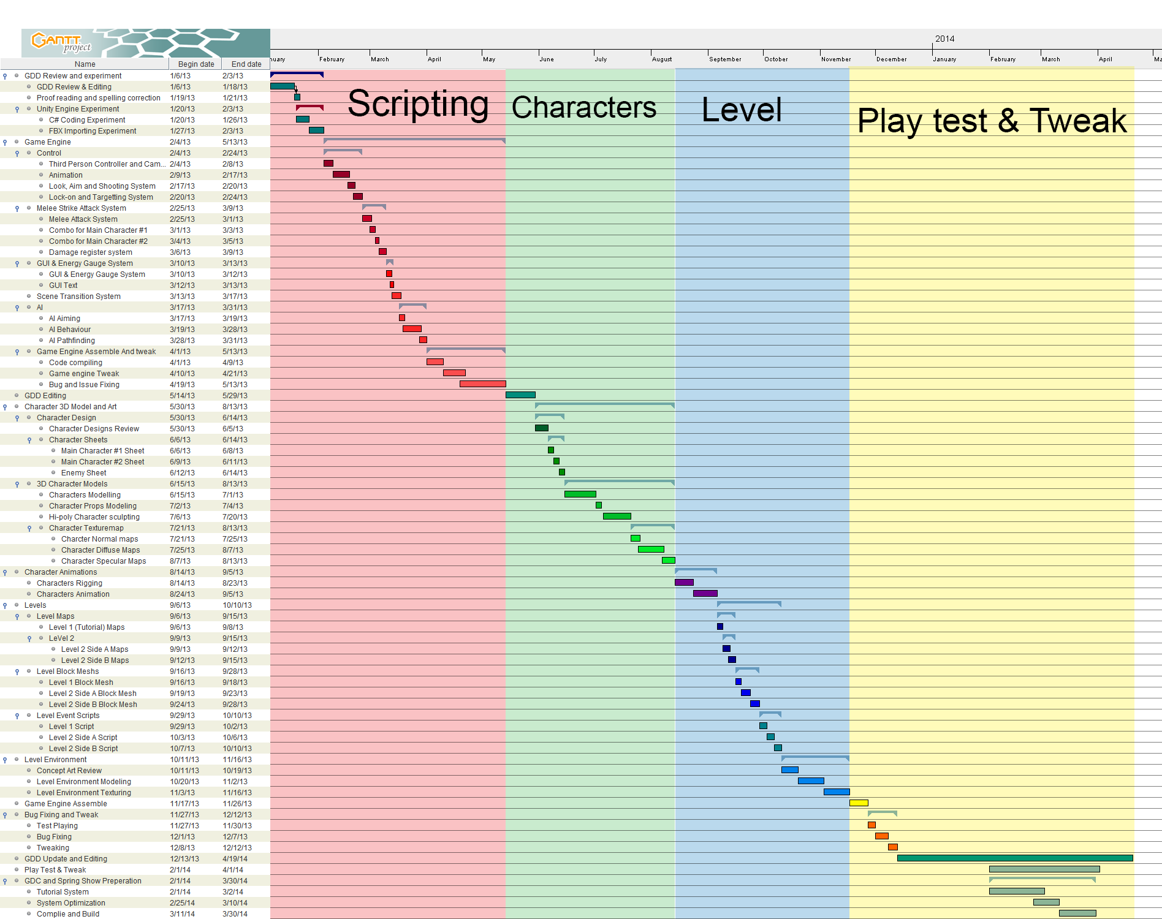
Gant Chart

Slide 13
One man studio
Since the time I came up with this project, I have decided to do it alone or with less people at much as possible.
The are both pros and cons between working alone and working as a group.
I have weighted both option and decided that only for this project, I will work alone. I will use help from outside but they should come in form of commissions.

Slide 14
Pro : I can do what I want.
My creative visions will be projected onto my game directly. I can control what will happen to player eyes.
Con: I easily lose my track.
It is hard to stay on track if there is no one helping you to keep your game in the track.

Slide 15
Pro : I can work anytime
I do not have to wait my team member to be ready to work. I can start working in the morning and call it a day when the day ends.
That mean I have load of hours to spend on in a day.
Con: I temporarily lost my social life.
The topic said it all.

Slide 16
Pro : I need less communication medium
I can spend less time on documents and more on development.
Con: None
Beside I actually lost my social life even more.

Slide 17
Pro : I can claim that I created everything
A system designer works are usually outshined by great visual graphic created by skillful artists in AAA games.
It creates more impact when I said that I created everything this game.
Con: Variety of skills are required.
There are reasons why studio hiring many people to work together. One of the reason is that people will help each other in the area they lack.
Though, I have minimum skills required for my project, I have limited content for my game. They level last for 7 to 10 minutes.
I have estimated that my game will double its quality for each member joined. (A group of 4 or 5 will be perfect)

Slide 18
Gameplay

Slide 19
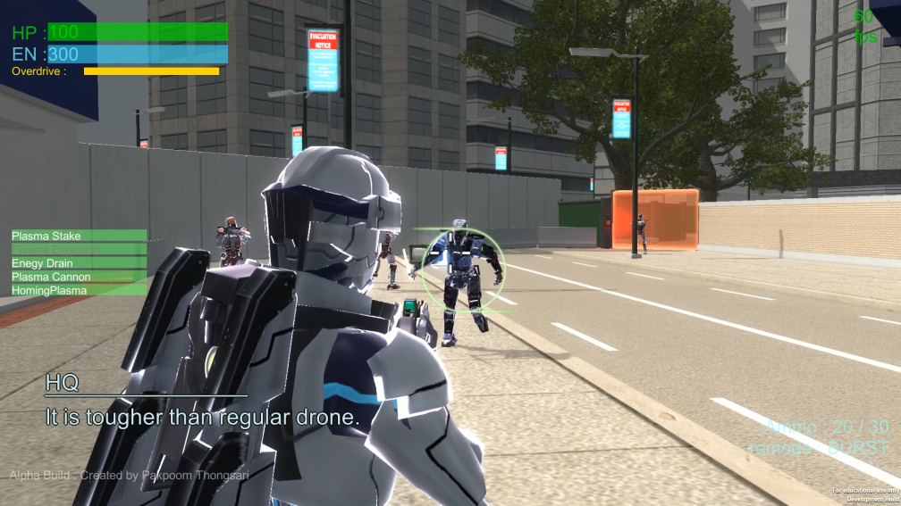
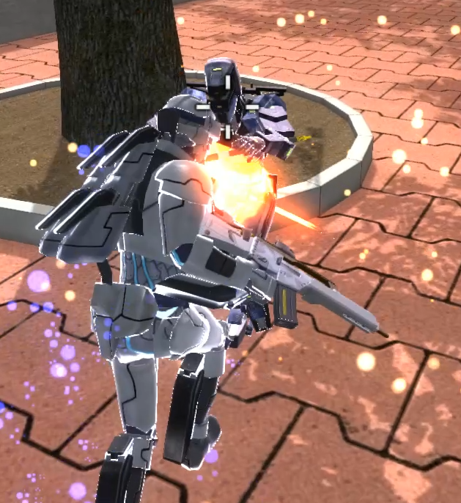
Gameplay Summary
V’s gameplay was designed to be a shooter game with some special melee attack system.
The goal was to allow player to quickly kill an injured enemy after it was damaged be gunfire.
However, the gameplay started to changed when the actual playable characters has been created.

Slide 20
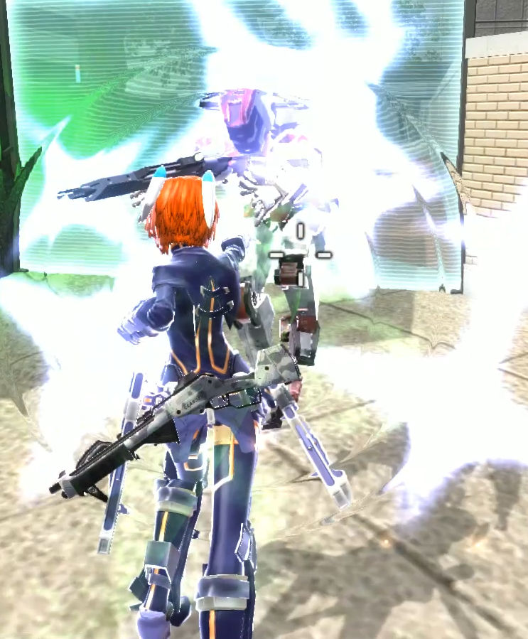
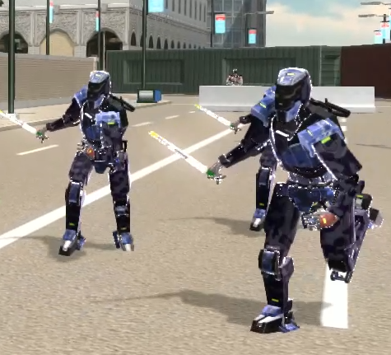
Gameplay Evolvement (1)
V’s gameplay has been shifted from “shooter” into more “action”.
The reason is that both Aston and Vesper are both strong and agile. They can dispatch gunner type enemy with no difficulty.
To balance that, Brawler type enemy has been created. The Brawler is tougher and faster. They are formidable enemy when come in pack.
The appearance of Brawler in the field changed the gameplay. Player is no longer able to blindly spam special attack without getting plucked by Brawlers.

Slide 21
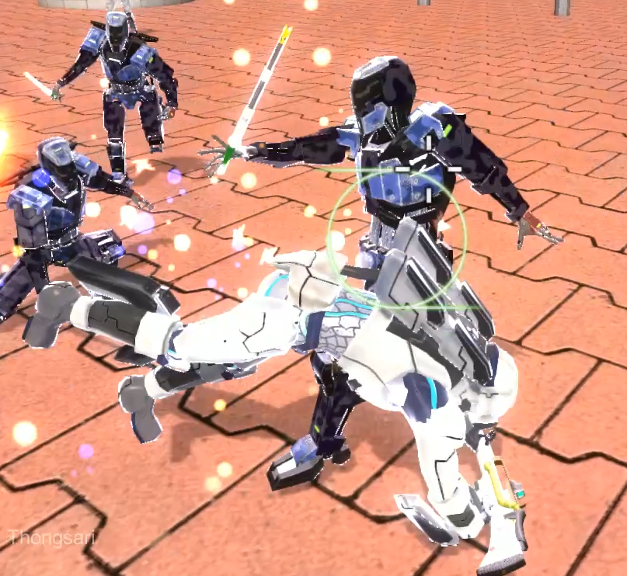
Gameplay Evolvement (2)
The gameplay has changed. Instead of going all out, player has to be carefully dodge Brawlers’ attack while aiming for an opening to counter.
“Float like a butterfly, sting like a bee” is a recommend strategy when fighting. Play safe is the good way to win.
Player can also focus on a single enemy while using gun or range attacks to stun/disrupt other enemies. Both character will not lose when in comes to 1 on 1 fight.

Slide 22
Visual

Slide 23
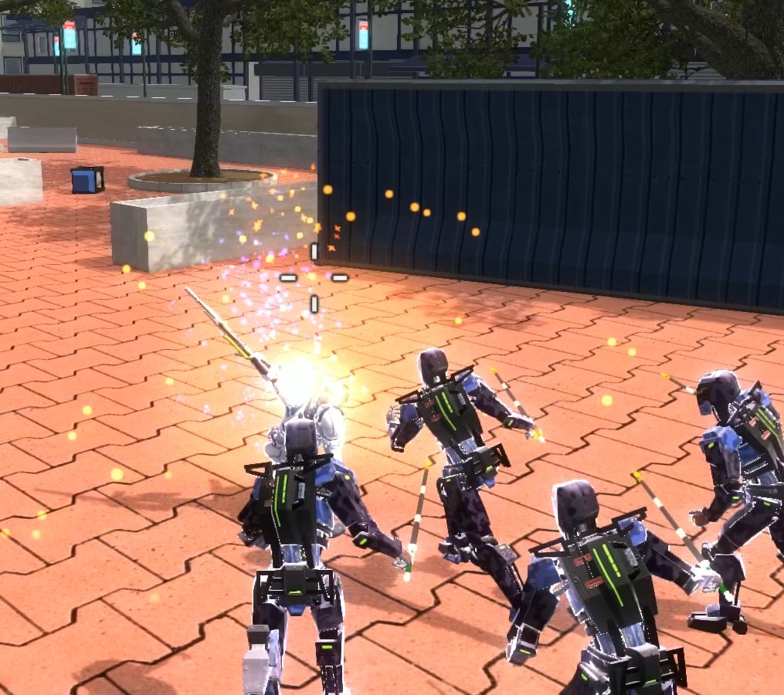
Visual and Graphic settings
Though my main focus is system designer, I also want to create a good visual to help me convey my game design ideas to others.
“Stylized” is the main visual objective from the beginning. Project V’ use cel-shade material for characters and weapons.
The reason I choose stylized over realistic is that I can spend less time on texturing while retains good visual quality.

Slide 24
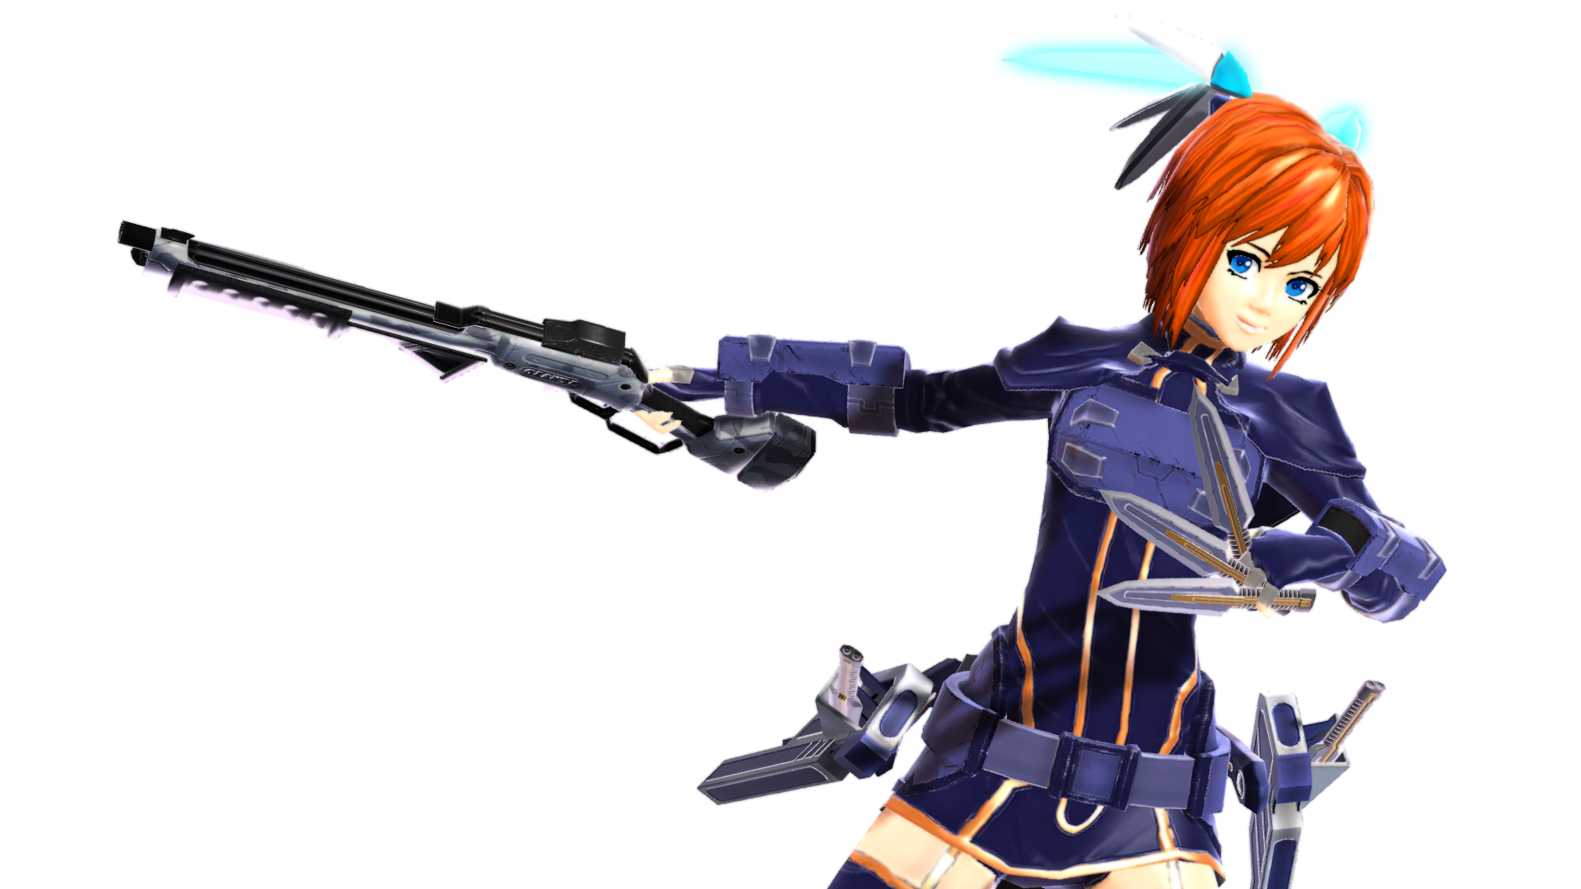
Characters

Slide 25
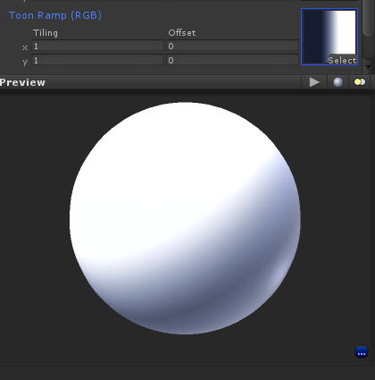
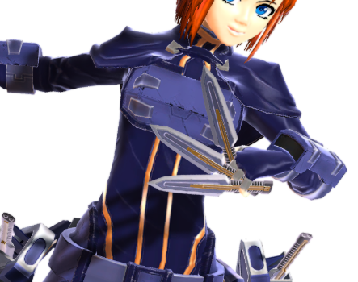
Character Shader
I have created and modify a shader based on Team Fortress 2’s. The shader utilizes one-dimensioned light warping texture.
I have also added some additional features on top of the shader.
The features are Non Photorealistic Rendering effect, Emission map and UV Animation.

Slide 26
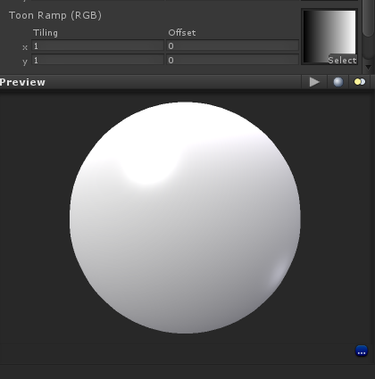
Diffuse light warping function (Cel-Shading)
The TF2 shader is based on a Half-Lambert material where the darker side will not turn completely black.
Then, it creates Cel-Shading properties by multiplying a color ramp texture.
By manipulate the ramp, I can define colors of light and shade of the object.

Slide 27
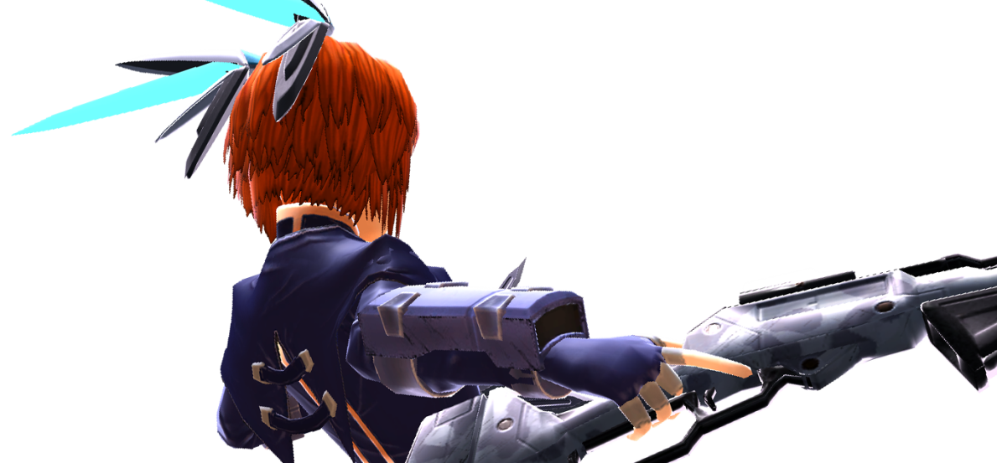
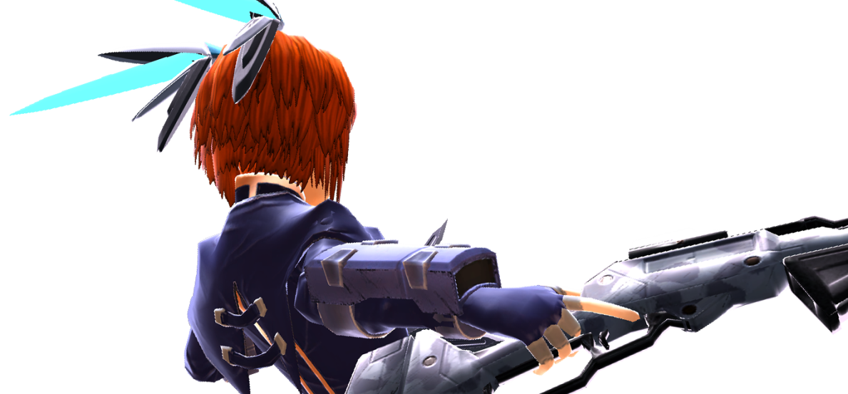
Non Photorealistic Rendering
One of the unique feature I have put into V’ shader is Non Photorealistic Rendering or NPR effect.
The NPR effect is a rendering method that is not defined by regular lighting logic.
The NPR effect for my game characters is rim lighting. The rim light appears on the edge of object depended on camera viewing angle.

Slide 28
Emission map & UV Animations
Beside NPR effect, I have also added emissive property to the character shader. The material will emit light and light emitting surface will not be affect by shadow.
The emissive uses marking texture which its UV can be moved via scripting. I can create UV animation by having script move the UV offset at the runtime.

Slide 29
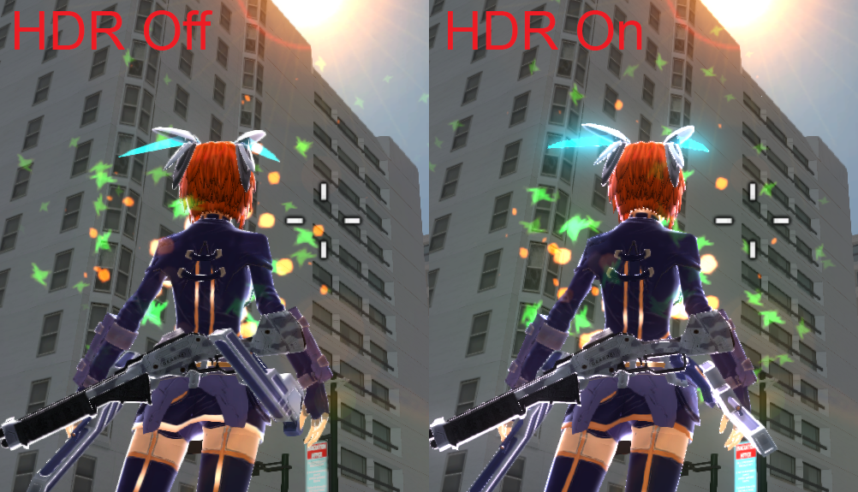
Post-rendering effects
High Dynamic Rendering has been enabled in-game. HDR and bloom filter effect combined together to create good visual for the game.
The game offers Anti Aliasing which can be turn off or on depended on player’s choice.

Slide 30
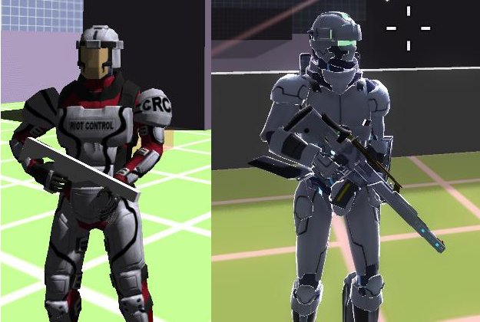
System & Combat Scripting
The reason that I chose to develop game scripting before art asset is that I will know what I need for this game.
It also created working pipelines that compatible with my game engine.
Thus, it helps my art assets require less adjustment before import into Game Engine.

Slide 31
Development

Slide 32
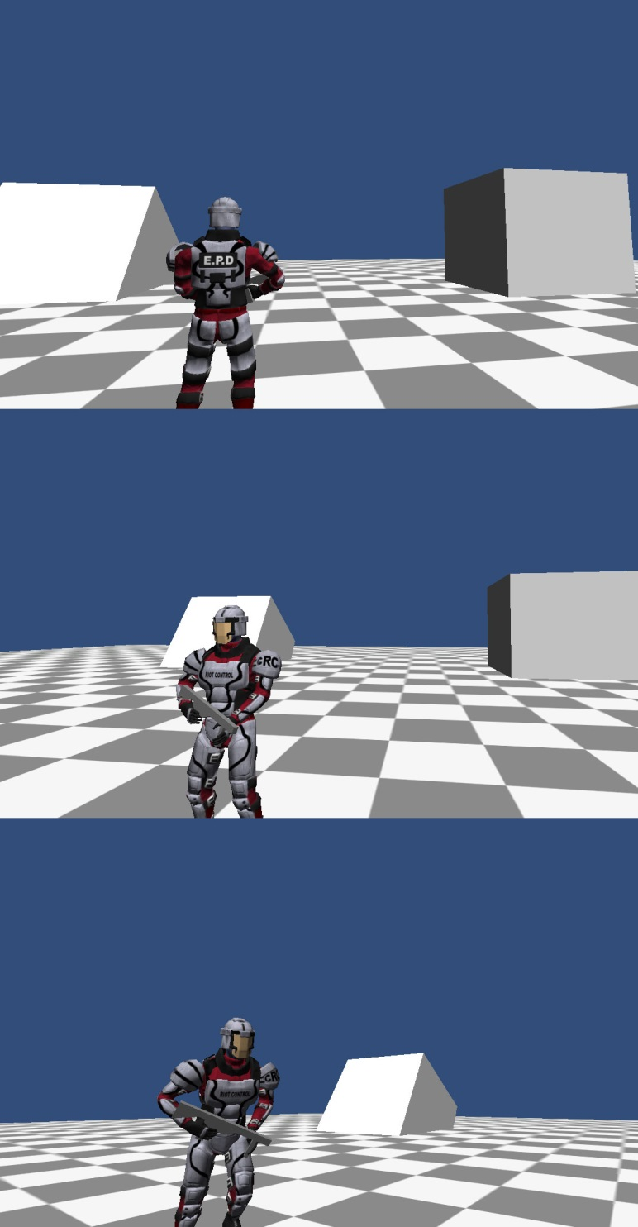
Place Holders
There is a character model used in this game before the current ones are completed.
By using this place holder character, I can easily swap the character model when I needed to. (Control and Animation script was already developed so I have no need to set up any new animation controller)

Slide 33
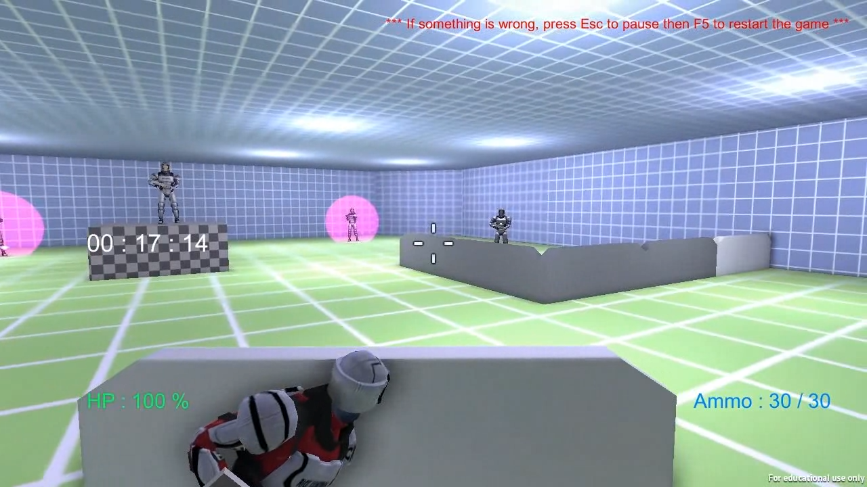
Spring show demo
During April, the basic shoot and melee combat system had been develop. I decided to create a game demo and submit to the 2013 Spring Show.
The first playable version uses prototype controller and has one tutorial level with time attack feature.

Slide 34
Characters

Slide 35
Character summary

Slide 36
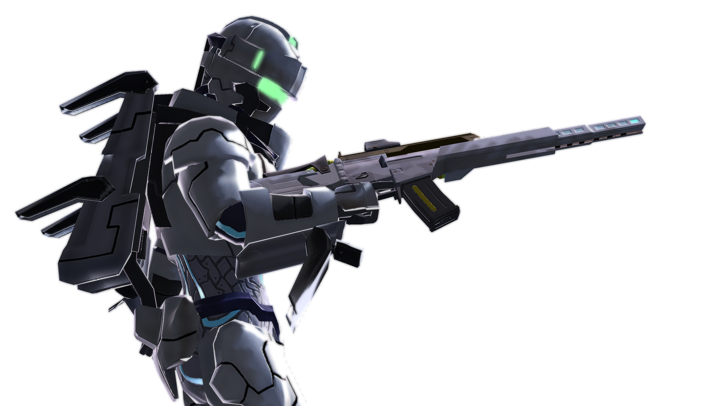
Aston

Slide 37
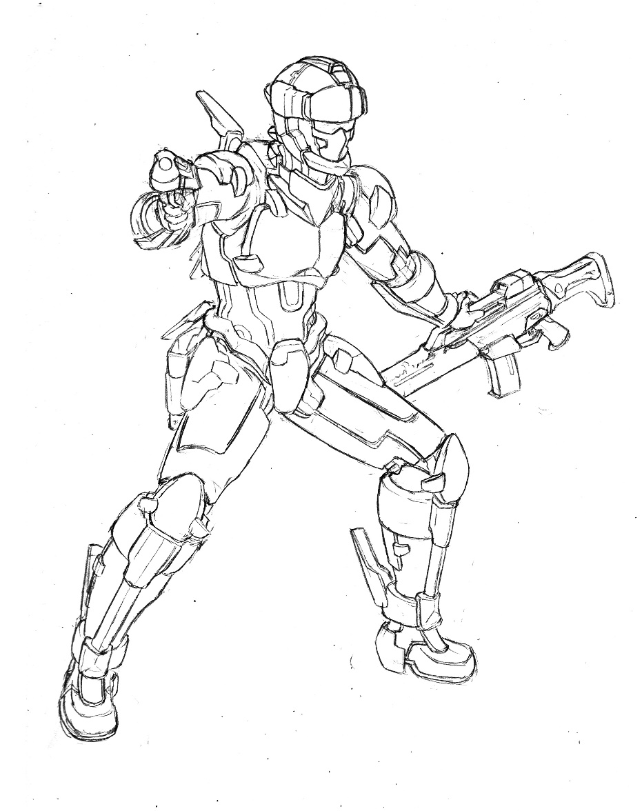
Name: Aston
Occupation: Mercenary
Fighting Style: Run & Gun / Crowd Control
Profile: A Mercenary commissioned to a certain company to test their Advanced Combat Armor. He is tasked to look after Vesper.

Slide 38
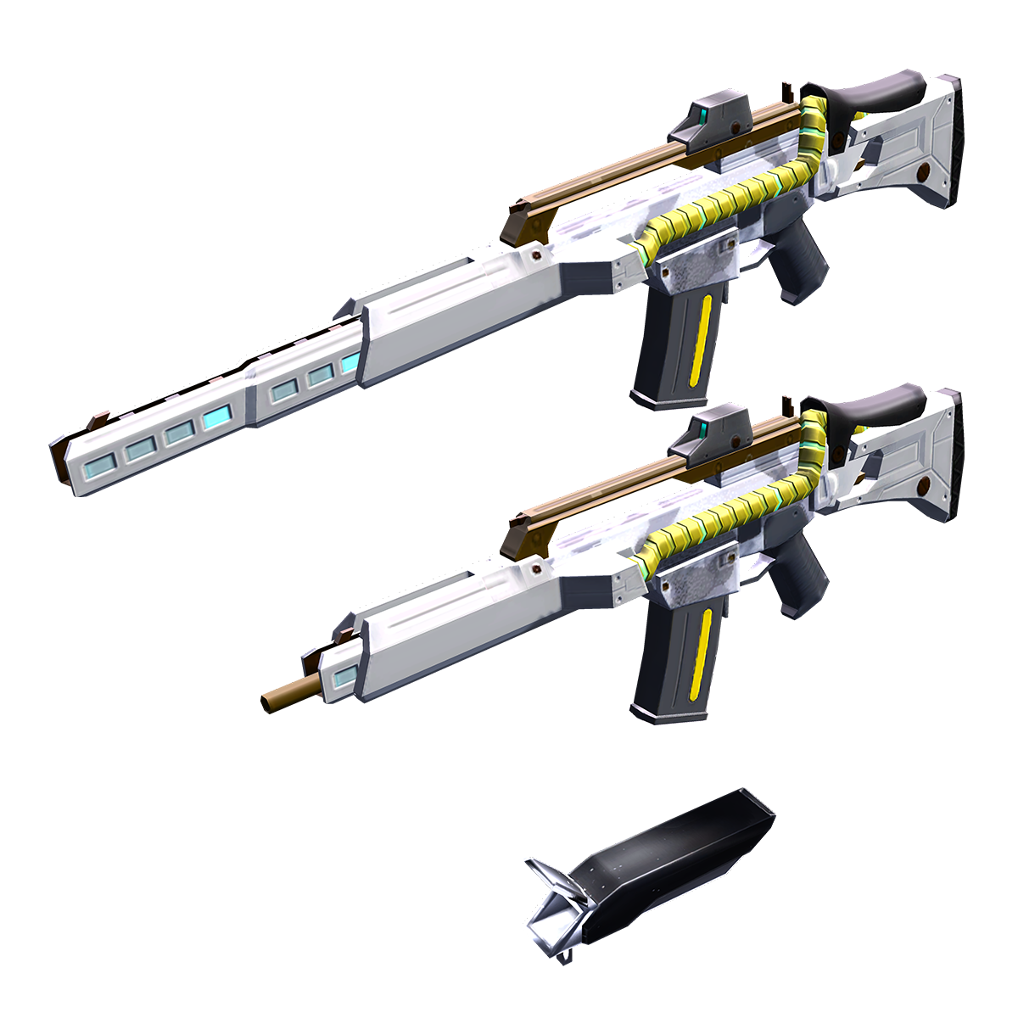
ACS Suit: White Horseman
Utilized Micro Fusion Reactor “Mini-Tokamak”
Featured numerous Plasma Thrusters and Plasma Discharger
Allow user to quickly navigate and complete demolition tasks through out a war zone
Weapon: G36 Accelerated Kit (ACK)
By utilized energy provided from ACS suit, it can shoot 5 successive bullets before the recoil affect the gun.
It also has regular full auto mode.

Slide 39
Vesper

Slide 40
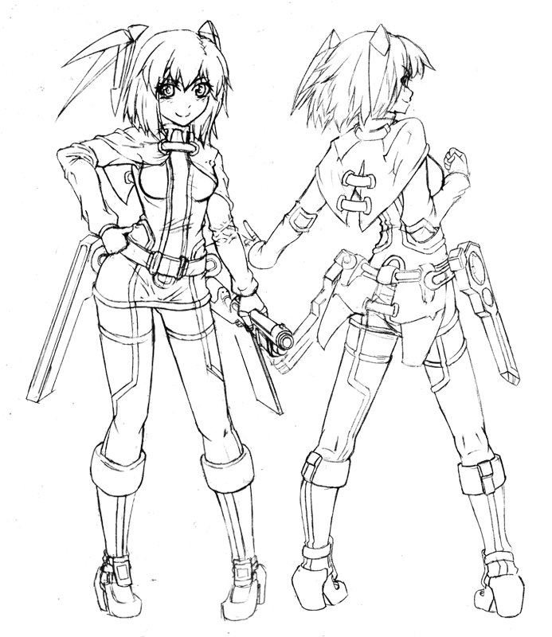
Name: Vesper
Occupation: Neet
Fighting Style: Close Combat
Profile: An Experimental Android created by the same company Aston working for. She often sneak out from facility to shopping with she is bored of the Internet.

Slide 41
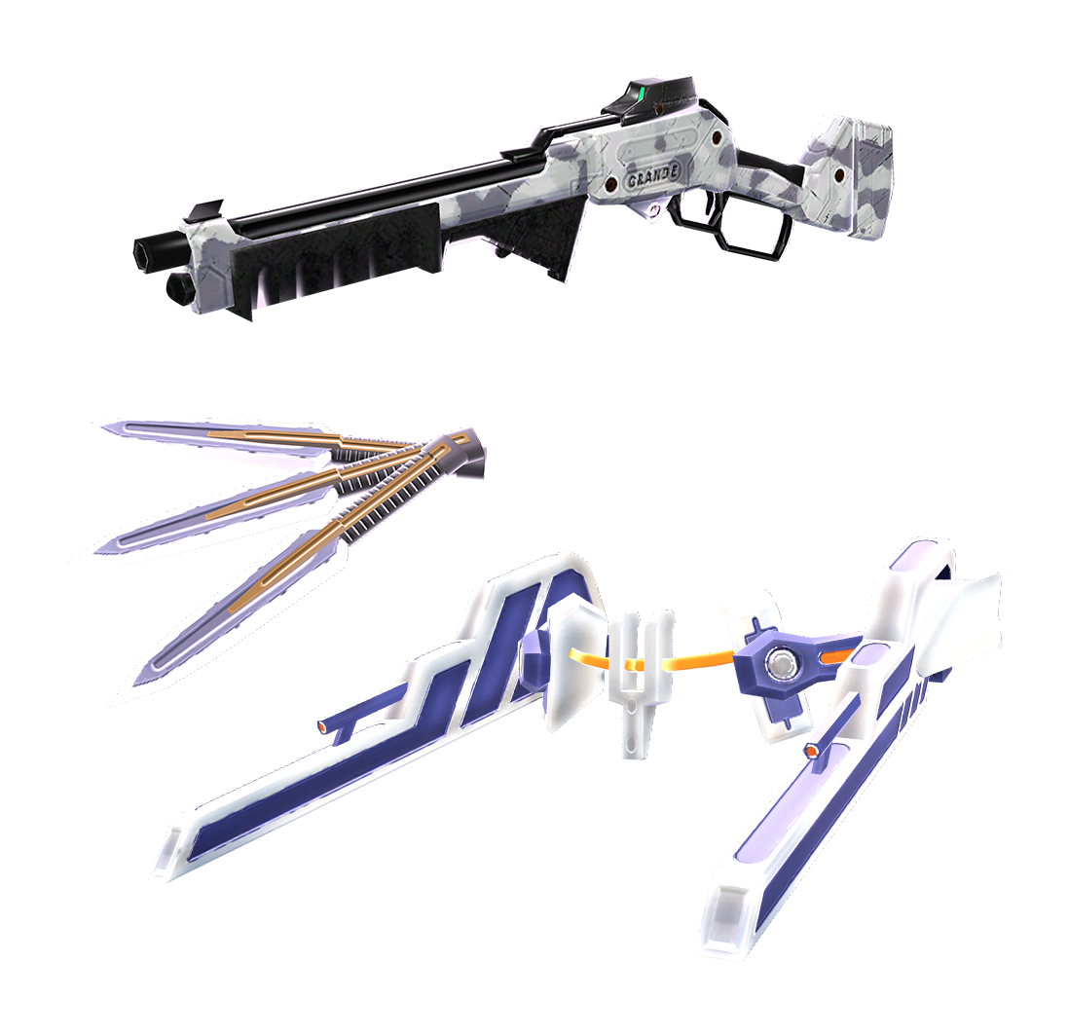
Mass Accelerator Unit
A Classified unit that allow her to increase or decrease object mass.
She can use it to make her body lighter and faster.
Usually, she makes her steel arm and shin guard to be heavy enough to break bones.
Weapon: Rossi Shotgun
A Semi-Auto shotgun. It use lever-action to cock or unload shells.
Weapon: Electric Kunai
An electrified short dagger. Capable of overloading enemy drone circuit system

Slide 42
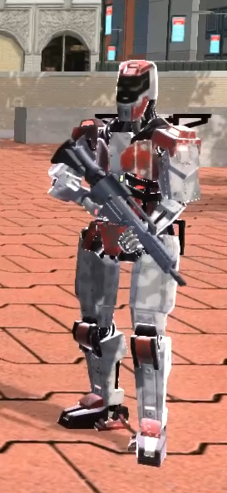
Enemy AI (Gunner)
Gunner is an enemy who uses ranged weapon to attack player. They will pursue the player if the player are out of sight but It will keep a distance from player.
Gunner is usually weak and does little damage. However, they are a great threat when the player’s HP is low. Gunner can easily kill low HP character so the player needs to take cover until HP is recovered.

Slide 43
Enemy AI (Brawler)
Brawler is a melee type enemy who pursues player though out the map once engaged.
Brawler has slow attack but has considerable damage. They are dangerous when travelled in pack.
Player has to carefully attack and retreat when facing Brawler. They can easily kill player if player is surrounded.

Slide 44
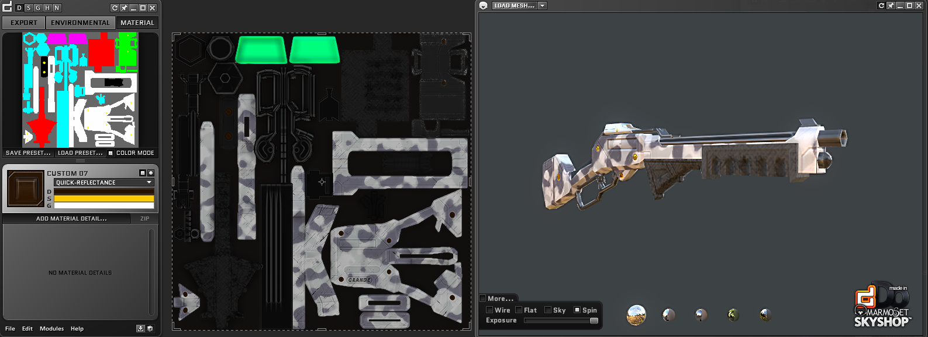
Texturing
Texturing is a skill that I have least confident. (Though I am quite confident in UV mapping)
By utilizing nDo and dDo, I can quickly create decent character and weapon textures.

Slide 45
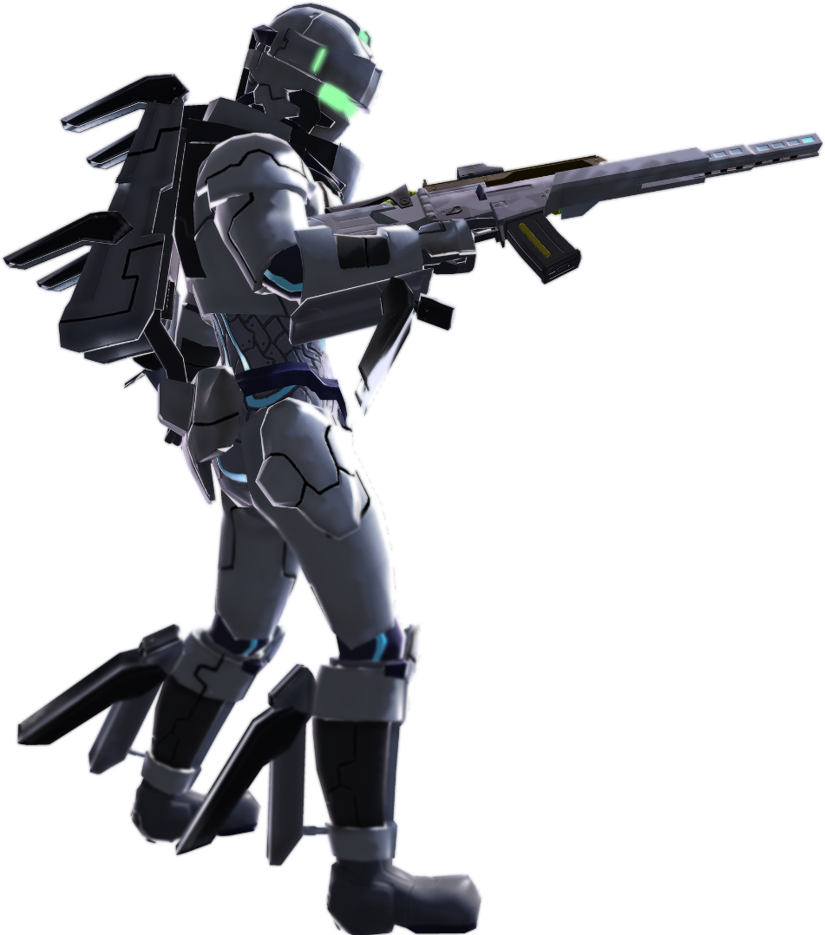
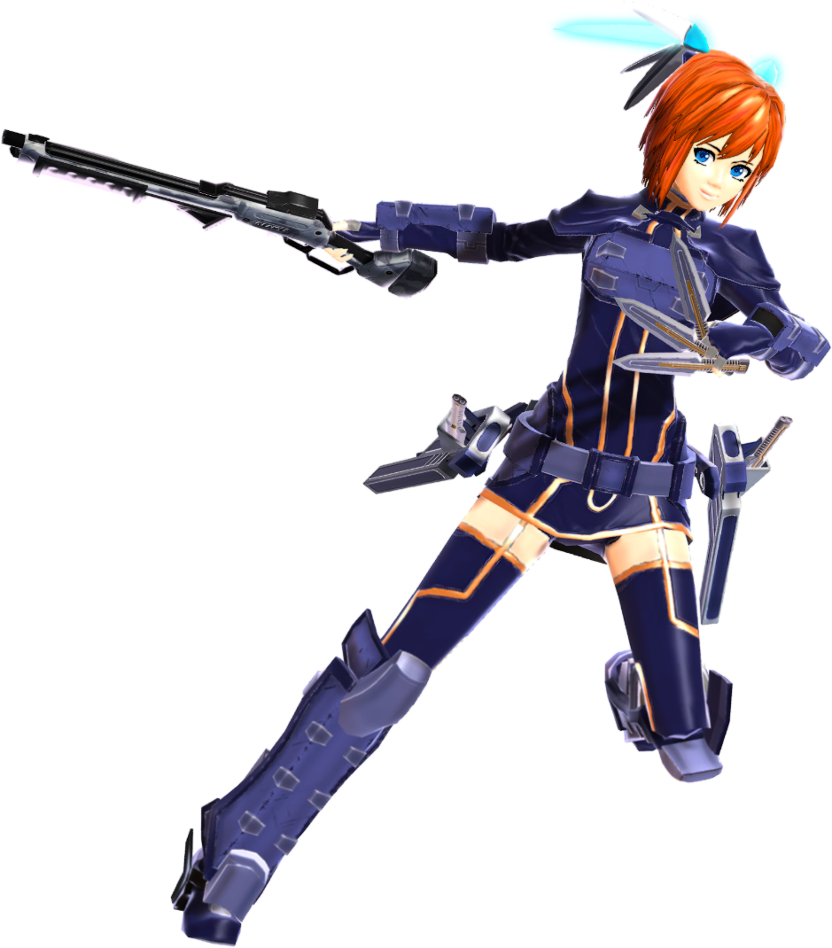
Character Shader
While Unity3d engine is capable of displaying beautiful materials, a custom shader script is needed.
Character shaders in Project V’ is based from Team Fortress 2’s.
I have added emission output with UV animation and non-photorealistic rim light rendering depended on viewing angle.

Slide 46
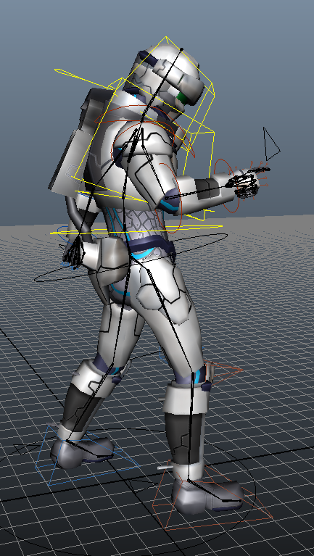
Rigging
All the characters (Except the place holder one) have been rigged by Mixamo.
The rigging processes are automatic so there are imperfects. The re-adjustments are needed.
The adjustments are Bones reposition and 25-30% of weight Painting.

Slide 47
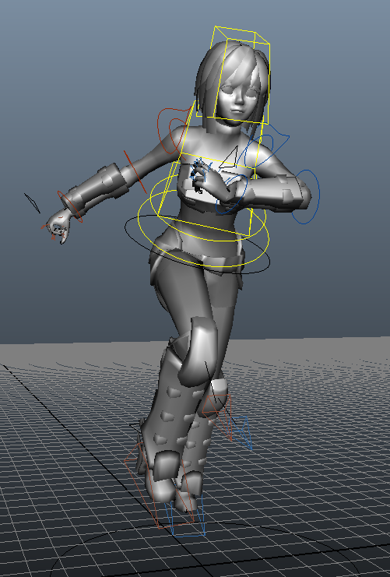
Animations
One of the reason I used the auto rigger service is that I can also use animation data they offer.
The animation data are recorded from motion capture. They are good animations but need some refinement if they are needed to be fit in my game.
Using Maya to retargeting the animations and export to Maya does not take much time. (If there is no bug and issue occur during the process. Unfortunately, the script I had at the time isn’t perfect. The new script they released on January fixed most of the problem)

Slide 48
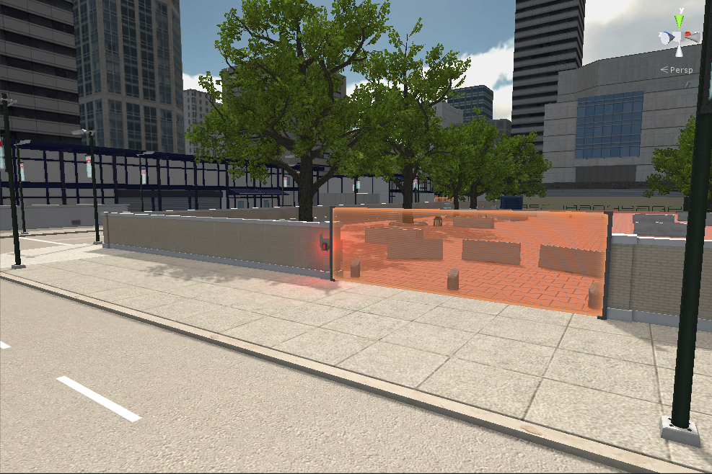
Environment

Slide 49
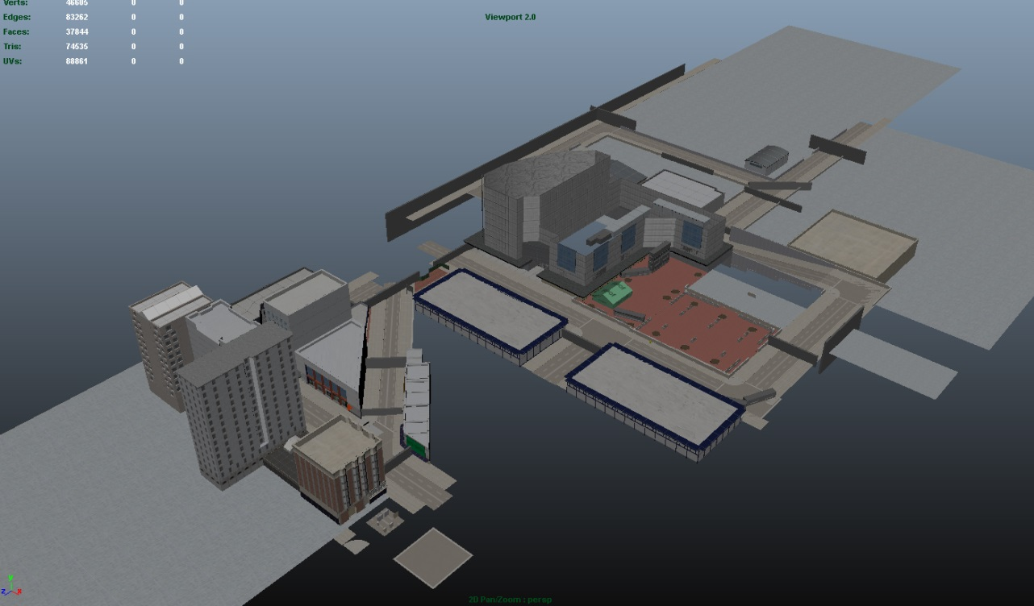
Environment Details
A city from 5 to 10 years in the future
Many structures should be the same as today
Use reference based on buildings in San Francisco
A Street lights and new posts has been re-design
Unity offers dual light maps rendering that can be used with real time lighting to improve performance.

Slide 50
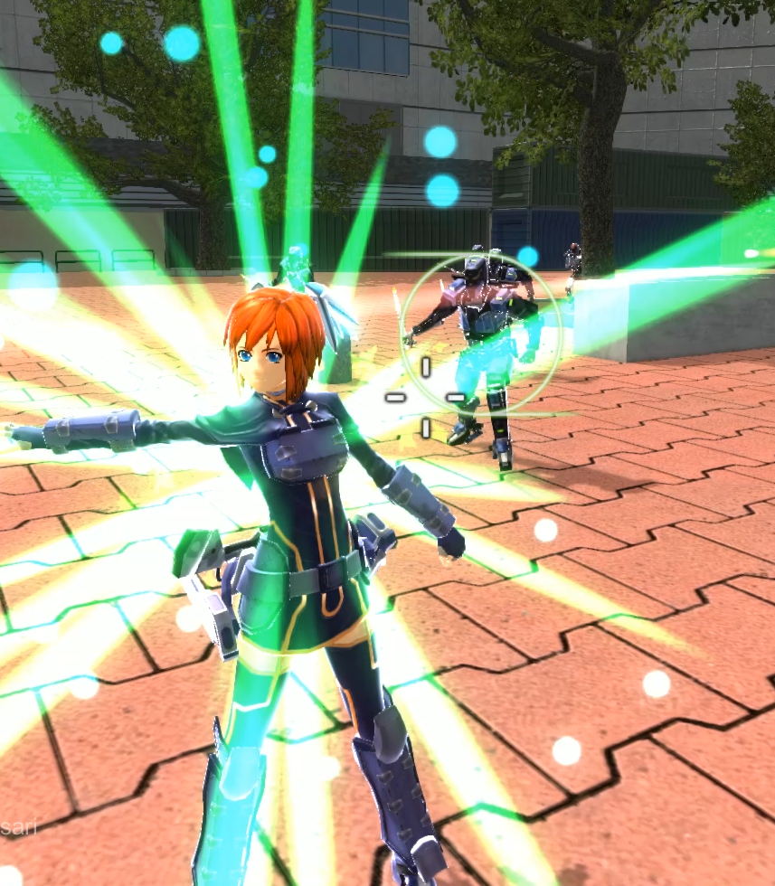
Tweaking
To balance the game, there are thing that need to be tweaked. (Most of them can be tweaked just by changing the numbers.) Changes are following
Character speed
Special Attack Delay
Weapon Spread
Energy gauge consumption
Enemy stun recovery time
Enemy Gunner accuracy
Enemy Brawler speed
Enemy Brawler attack length
Player/Enemy damage output.
*Overdrive mode which grant player new finishing moves is actually over-powered. I put it in order to help player win the two last hordes in the game.

Slide 51
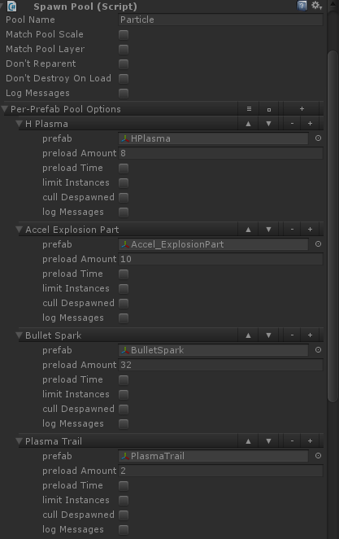
Pool Management
I integrate Pool Manager in my game on February 2014 and 99% of objects are spawned and de-spawned using Pool Manager.
Using Instantiate and Destroy object function in Unity is easy to perform but it creates some leftover in memory. It will affect performance in the long run.
It is better just to disable game objects and enable them later.
Pool management has cut down 30% of memory usage while slightly increases loading time.

Slide 52
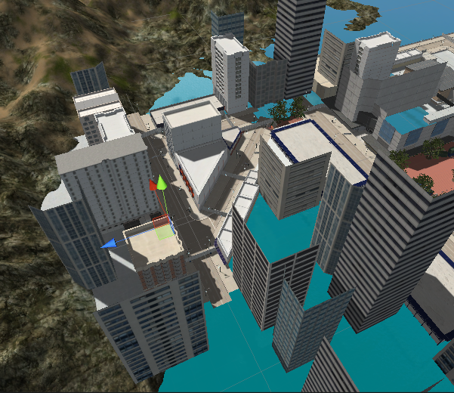
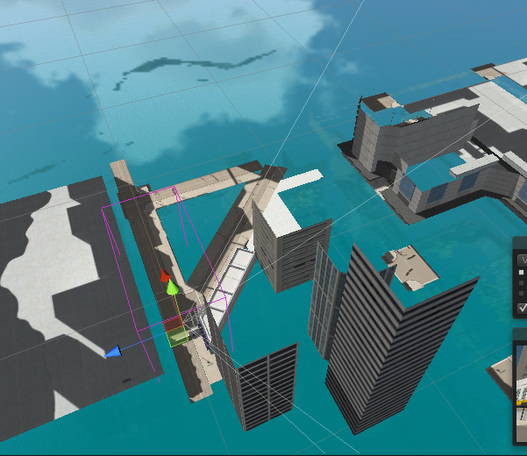
Culling Occlusion
I do not use Level Of Detail (LOD) on my environment meshes. To improve graphic performance, I decided to use Culling Occlusion system to unload meshes that are off camera viewing angle.
The draw call without culling is 1800-2100. And the draw call is reduced to 500-800 when occlusion is enabled.

Slide 53
Test play
Project V’ features became more complex every weeks. More features equal more bugs.
By having my friends play and report bug, I can easily issue problem and fix then.
There are also gameplay feedbacks. Something I thought it will work is not work. Then, I have to rethink the approach again.
Each time I got bug reports or feedback, my game is improve in some aspect.
The first tester has been testing this game since April 2013. It should be a year when this slide is presented.
There are more than 150 fixes during 14 months of development

Slide 54
What I have learned

Slide 55

Thank you

Slide 56
Game Features (Control & Combat)
Run/Sprint/Glide
Dodge Moves
Aim/Zoom
Guns/Reloading/Fire mode
Melee Attacks
Special Attacks (Close-Quarter)
Special Attacks (Range)
Overdrive Mode
Special Attacks (Overdrive)

Slide 57
Game Features (Characters)
Aston
Vesper
Color ramp cel-shading
Non Photorealistic Rendering
Emission and UV Animations
Character Rig (Mixamo)
Character Animations retargeting (Mixamo)
Unity Mecanim
Humanoid Rig (Unity Mecanim)
State Machine (Unity Mecanim)
Animation Transition
Animation Layers
Animation Events
Character Inverse Kinematic

Slide 58
Game Features (System)
Lock-on System
Homing Weapons
GUI
Enemy AI (Gunner)
Enemy AI (Brawler)
AI Pathfinder
3D Sound system
Music Player
Pause Menu and Options

Slide 59
Game Features (Level)
Environment
Event Triggers
Check Point

Slide 60
Game Features (Aesthetics)
Anti-Aliasing
HDR and Bloom
Visual Effects

Slide 61
Game Features (Performance)
Culling Occlusion
Pool Management

Slide 62
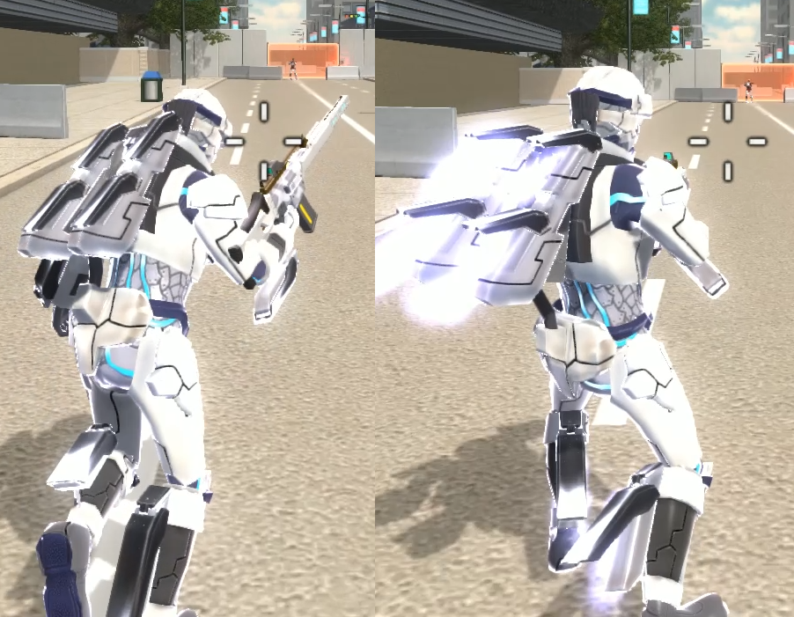
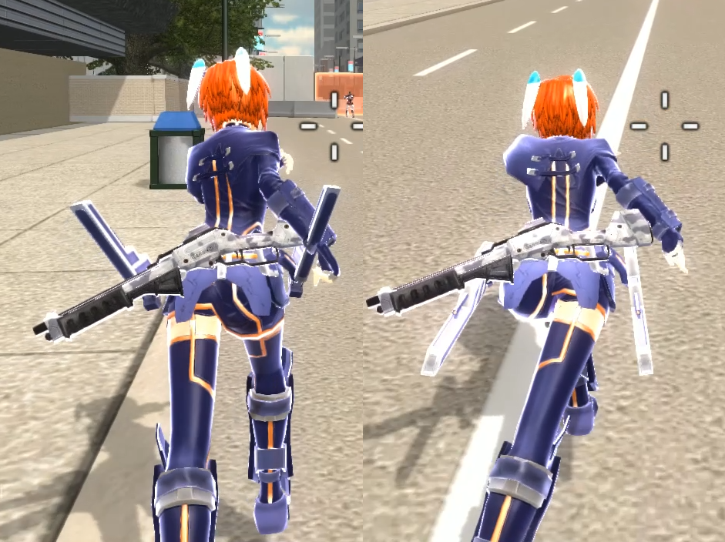
Run/Sprint/Glide
Aston and Vesper can quickly navigate through out the level by utilizing Glide or Sprint mode.
Glide mode allow Aston to move faster while still be able to use range weapon such as his G36 or Homing Plasma attack
While vesper cannot attack while sprinting, she has more movement speed than Aston.

Slide 63
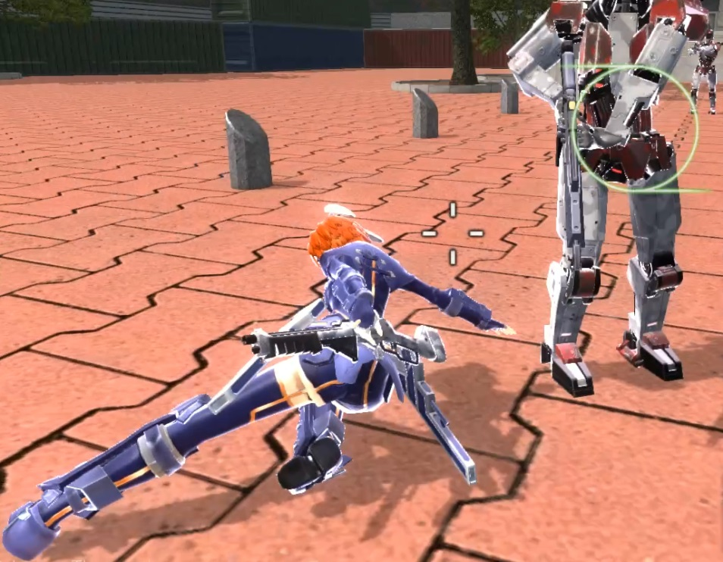
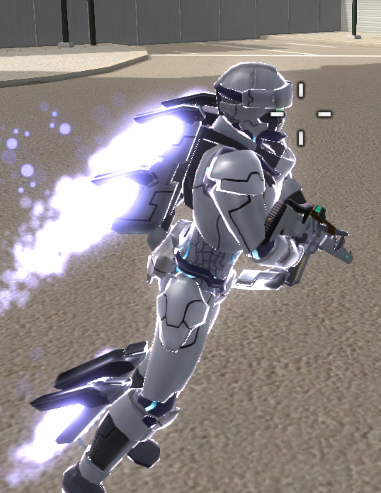
Dodge Moves
Aston and Vesper can perform evasive maneuver by pressing an assigned button.
Vesper has three different dodging animations depended on the direction she moves to. Though, every moves has the same function.
Aston has two approaches on dodge. The first one is the same as Vesper where Aston roll into one direction. The second is when Aston perform the movement while Gliding. Aston will temporarily increase his move.
Aston also enter Super Boosted mode by holding the assigned button after the dodge movement.

Slide 64
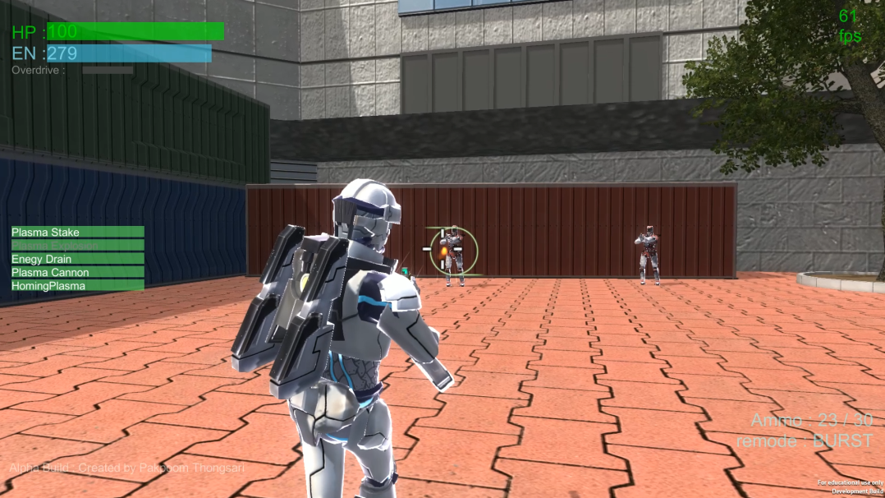

Aim/Zoom
Project V’ offers Run & Gun gameplay. The character will enter aiming stance once the fire button is pressed.
The game also offers zooming mode if player need to aim at target from afar.

Slide 65
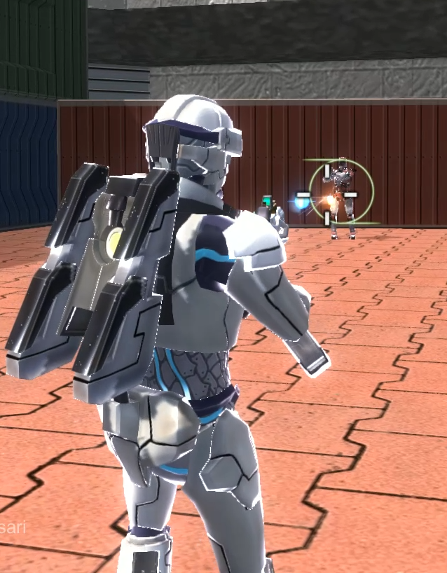
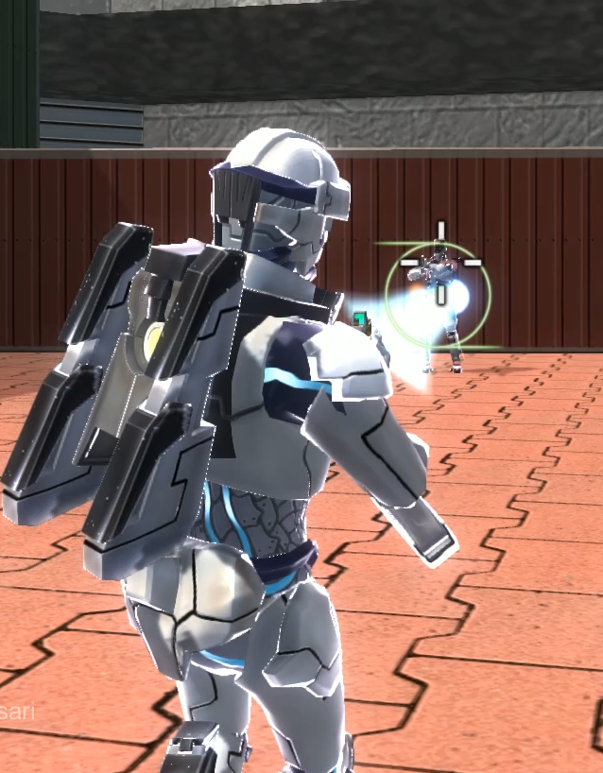
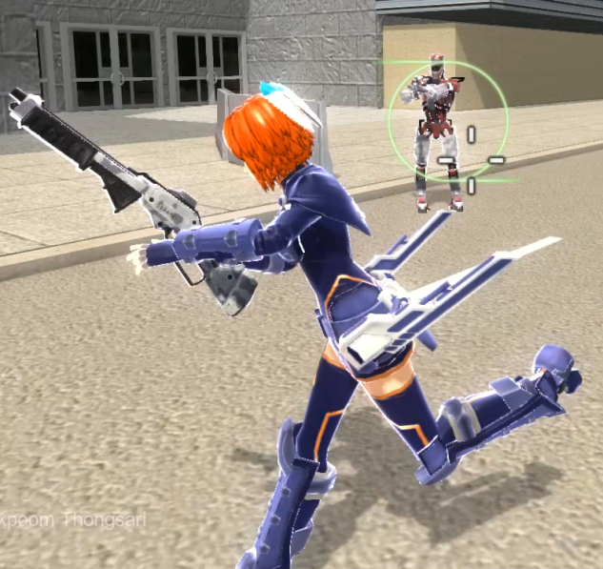
Guns/Reloading/Fire mode
Even though weapons in this game seem to be less powerful than special melee attack, it is still quite handy when player need to attack enemy from range.
Aston’s G36 has two firing mode Full Auto or Burst Fire. The first acts like regular assault rifle. He second one consume five bullets per shot but is extremely accurate an has penetration ability.
Vesper’s shotgun has only semi-auto fire mode. The gun does impressive at close damage but it becomes weaker

Slide 66
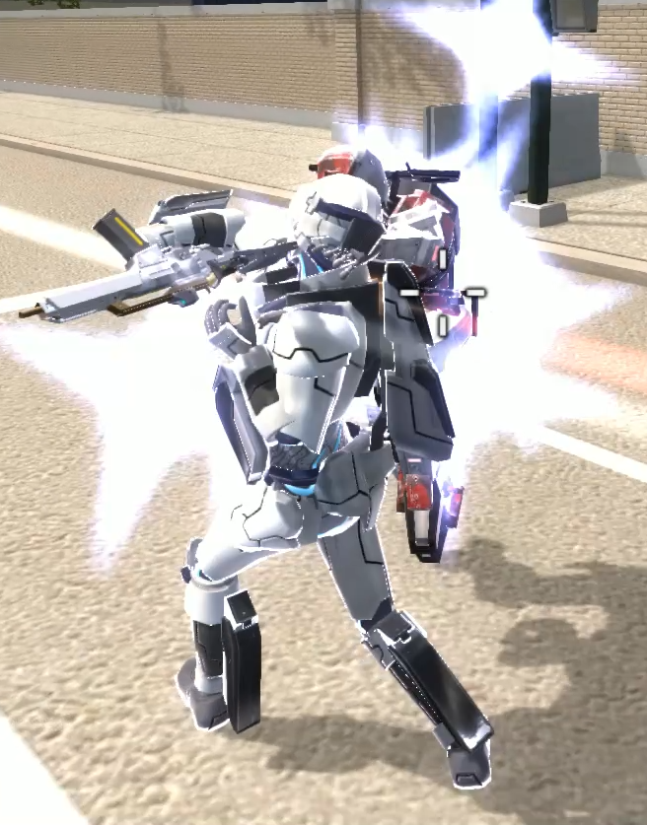
Melee Attacks
Aston and Vesper can perform a quick-swift attack that shoves enemy back.
Melee damage output is not high but capable of finished wounded enemy.

Slide 67

Special Attacks (Close-Quarter)
A special feature of this game. Player character can dash forward into an enemy and perform high damage melee attacks.
Aston uses his backpack thruster to boosts his speed and attack an enemy with Plasma Discharger installed on his arm armor.
Vesper, however, is slower than Aston but her attacks are stronger and can perform three attacks in a row.
Aston and Vesper also chain to their alternate attacks. Aston can perform energy drain that refill his energy. Vesper has fatal strike that very high damage output, capable of one hit kill the enemy.

Slide 68
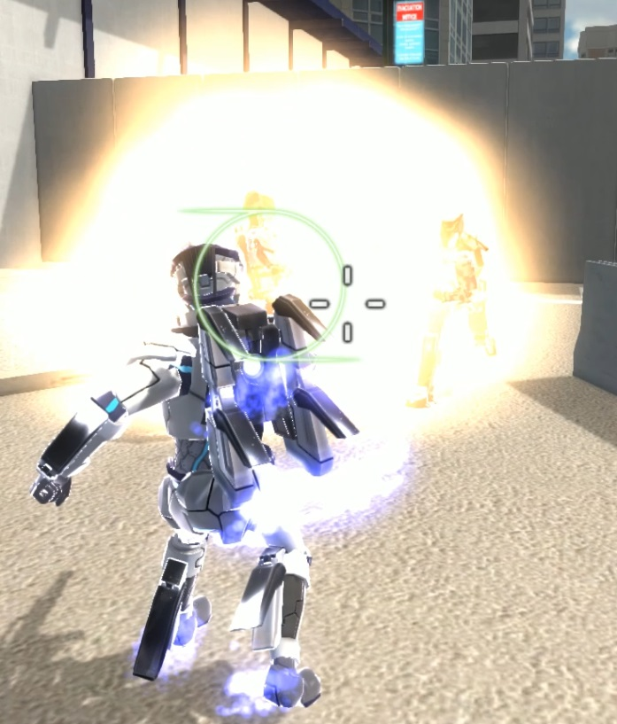
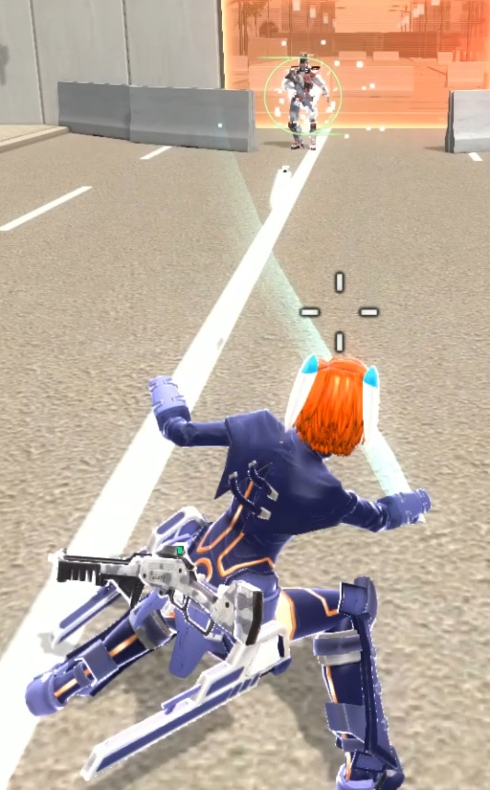
Special Attacks (Range)
Both character can perform ranged special attacks to slow down or kill incoming enemy.
Aston fire plasma cannon from his arm armor. The attack can hit multiple enemies at once.
Aston can also mark targets and shoot homing projectiles to a single or multiple target at once.
Vesper throws flying daggers to a target. Each dagger us not strong but it is capable to stun an enemy at range. Vesper throws a total of four daggers in a full combination.

Slide 69
Overdrive Mode
Overdrive Mode grants faster movement speed, faster energy regeneration and additional attacks for Aston and Vesper once triggered.
An overdrive gauge must be at least 80% to trigger Overdrive mode on.

Slide 70

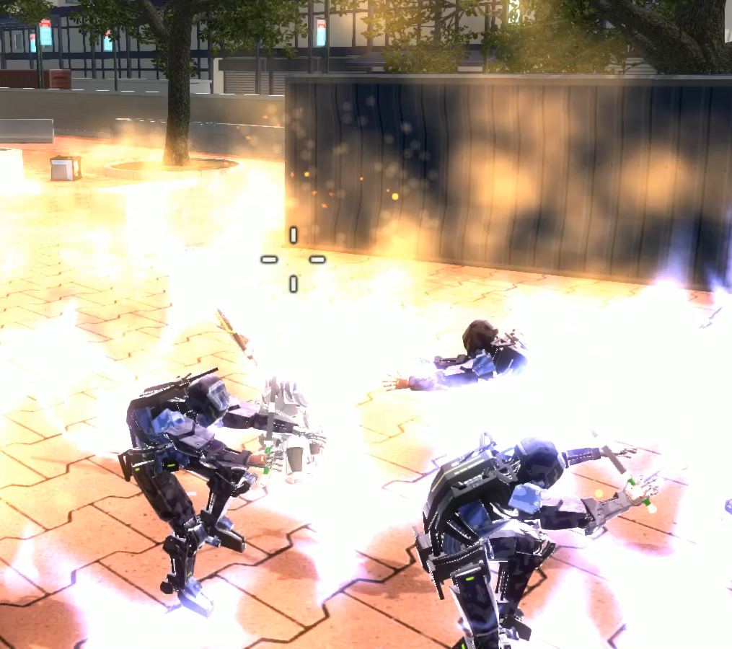
Special Attacks (Overdrive)
The new special attack gained from this mode can take on multiple enemy at once.
However, Overdrive gauge is drained each time the overdrive attack is performed.

Slide 71
Aston
Aston has ranged and crowd control fighting style. He utilizes weapon installed on his combat armor such as Plasma Dischargers and thruster.
The character features variable back thrusters and function arm and leg cannons.

Slide 72
Vesper
Vesper is a close combat type character. Her kicks combined with steel leg guards are capable of incapacitating enemy drones. She also uses electrify kunai stored in waist binder to attacks enemy.
The character features waist binder that automatically opens when kunai is needed.
Also, sensor compartments will open when Overdrive Mode is triggered.

Slide 73
Color ramp cel-shading
Character shader based on Team Fortress 2 shader utilized color ramp to define light and shade color.

Slide 74
Non Photorealistic Rendering
Non Photorealistic Rendering or NPR is a rendering that is not defined by regular lighting logic.
The NPR effect for characters is rim lighting. The rim light appears on the edge of object depended on camera viewing angle.

Slide 75
Emission map & UV Animations
Beside NPR effect, I also added emissive property to the character shader.
The emissive uses marking texture which its UV can be moved via scripting. I can create UV animation by having script move the UV offset.

Slide 76
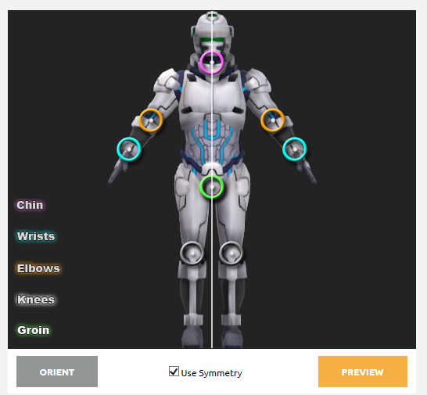
Character Rig (Mixamo)
To shorten amount of time to Rig, I use Mixamo auto rig service.
After bones location and paint weight are cleaned up. I can use the script to easily create control rig.
The control rig feature IK/FK switch and several features animator would like to use it.

Slide 77
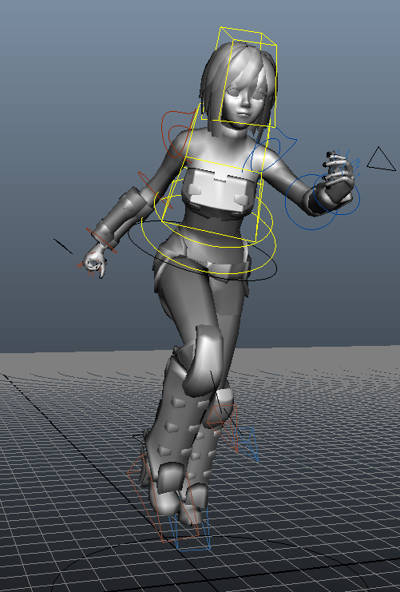
Character Animations retargeting (Mixamo)
Mixamo also offers character animation data that can be applied to any characters rigged by its auto rigging.
I can also use the control rig to retarget the animation data such as arm or leg position and poses.

Slide 78
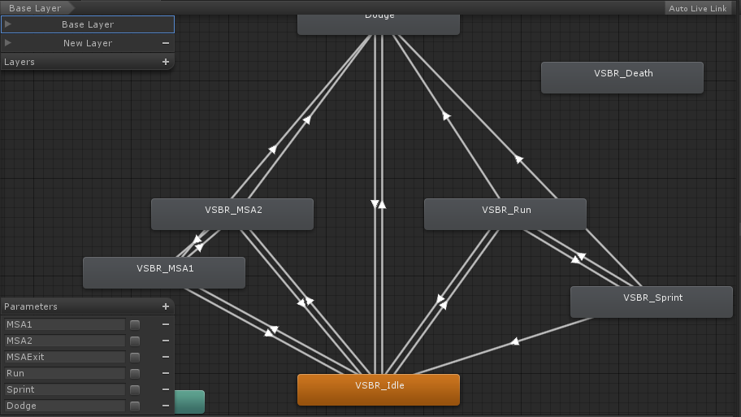
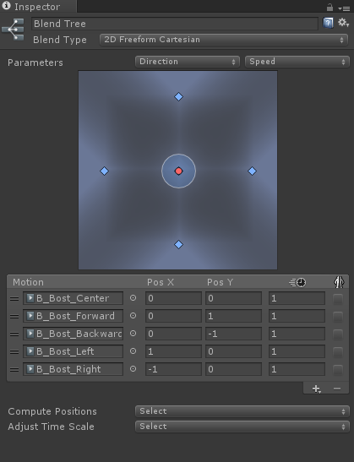
Unity Mecanim
Starting from Unity3d 4.0, Unity engine offer a new animation system called Mecanim.
Mecanim features visualized state machine and humanoid rig which helps developer integrates animations into game.

Slide 79

Humanoid Rig (Unity Mecanim)
One of the most useful features of Unity Mecanim is Humanoid Rig retargeting.
The feature enable animation from one rig to be applied to another rig with different set up. It enable animation to be share as long as they are humanoid biped rig.
This allows me to share animation to different character or apply a same motion data to a character even if I made a changes to the rig itself.

Slide 80
State Machine (Unity Mecanim)
State machine is one of Unity Mecanim feature. It visualize character animation states. It less the number of script that needed to drive animation.
The state machine also handles blend parameter. This helps adjusting animation transition is possible during runtime.

Slide 81

Animation Transition
The Mecanim state machine visualize animation mapping. And the transition between two animation can be configured within this mapping.

Slide 82


Animation Layers
It is possible to play two animation simultaneously with animation layers.
The second layer can override the current animation or adds movement to current animation.
Also, animation mark can be applied to characters. For example, the system can play only arm joints animation while the rest still play their current animation.

Slide 83

Animation Events
In Unity 4.3 a new feature has been added to Mecanim system. The new feature can trigger a function in a script at a certain frame.
This enable developer to play sound or turn on collision at the exact time they want to.

Slide 84


Character Inverse Kinematic
Inverse Kinematic or IK is need for creating third person character shooter game. Character arms and head need to look at where cross-hair pointed to.
IK set up from Maya will not be exported to Unity, so dedicated IK script is needed.

Slide 85

Lock-on System
Lock-on System is a unique feature of Project V’. The system marks an enemy as a target where special attack will aim for.
The system allow player to keep track of locked-on enemy though wall and help player attack off-screen enemy. This help player attacking enemy after perform an evasive movement.
It also helps player to keep track of Aston’s Homing Plasma attack.

Slide 86

Homing Weapons
Aston can use his backpack to fire Homing Plasma which tracks assigned target.
To mark targets player only need to move an aiming reticle over a desired target. Once the attack button is released, the homing plasma will start homing toward targets.
Aston can swiftly fire Homing Plasma if the attack is chained form other special attack.

Slide 87

Graphic User Interface (GUI)
GUI in Project V’ displays character status such and current hit point , energy level, overdrive mode timer and bullet count. It also displays status of special attack and current fire mode of a weapon used by character.

Slide 88
Enemy AI (Gunner)
Gunner is an enemy who uses ranged weapon to attack player. They will pursue the player if the player are out of sight but It will keep a distance from player.
Gunner is usually weak and does little damage. However, they are a great threat when the player’s HP is low. Gunner can easily kill low HP character so the player needs to take cover until HP is recovered.

Slide 89
Enemy AI (Brawler)
Brawler is a melee type enemy who pursues player though out the map once engaged.
Brawler has slow attack but has considerable damage. They are dangerous when travelled in pack.
Player has to carefully attack and retreat when facing Brawler. They can easily kill player if player is surrounded.

Slide 90

AI Pathfinder
By utilizing Unity Navigation Mesh or NavMesh system, enemy characters can navigate around an obstacle.

Slide 91

3D Sound system
Project V’ feature 3D sound system that will emit sound at the exact position.
The game support surround speaker system.

Slide 92

Music Player
If triggered, the music player in game will playing music during fight.
Player can change the music volume in option where the volume slider is separated with the main volume slider.

Slide 93


Pause Menu and Options
Project V’ features pause menu where player can change setting.
The settings such as mouse sensitivity, zoom mode, graphic quality, anti-aliasing and FPS display can be change in option.
Player can also check system information in option menu.

Slide 94

Environment
The level featured in Project V’ has objects which provides cover or block player’s path until all enemy is killed.

Slide 95

Event Triggers
There are invisible trigger collider placed though out the game level.
Once triggered, it can either spawn enemies, close gate, save check point, play message or start music.

Slide 96

Check Point
The game features check point so player will not have to play the level again from the beginning if player already made progress.

Slide 97

Anti Aliasing (AA)
Player can enable AA in the option menu.
The AA modes are provided by Unity Image Effect.

Slide 98
HDR and Bloom
High Dynamic Rendering has been enabled in-game. HDR and bloom filter effect combined together to create good visual for the game.

Slide 99

Visual Effects
I have made particle effects used in the game myself. I also scripted them to be de-spawned after it is played after a certain time.

Slide 100
Culling Occlusion
I do not use Level Of Detail (LOD) on my environment meshes. To improve performance, I decide to use Culling Occlusion system to unload meshes that are off camera viewing angle.
The draw call without culling is 1800-2100. And the draw call is reduced to 500-800 when occlusion is enabled.

Slide 101
Pool Management
Using Instantiate and Destroy object function in Unity is easy to perform but it creates some leftover in memory. It will affect performance in the long run.
It is better just to disable game objects and enable them later.
I integrate Pool Manager in my game on February 2014 and 99% of objects are spawned and de-spawned using Pool Manager.

